Slide 1

SAFETY
responsibilities
FOREMAN TRAINING

Slide 2

Module 1
Setting the Foundation
why safety matters, and who leads

Slide 3
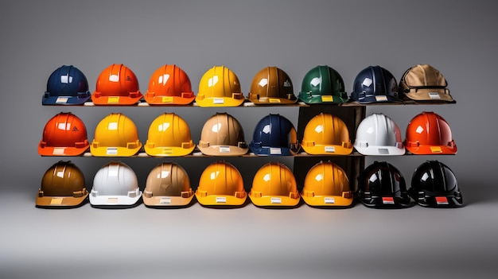
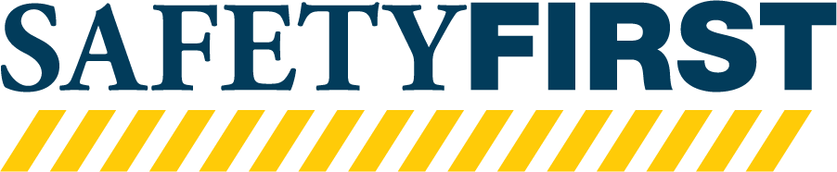
As a Foreman, you play a vital role in ensuring safety for yourself and your team.
Remember, you are a part of Safety; you are safety. We are safety.
Notes:
Welcome to this important training on safety leadership. As a Foreman, you are essential in maintaining a safe workplace environment. Today, you'll learn how your actions, decisions, and attitude directly impact your team's safety culture. Remember, your commitment to safety can influence the entire crew's approach to their work. Reflect on your own experiences with safety and what you hope to gain from today's session.
Our primary objectives today include clearly understanding your role as a safety leader, improving communication around safety issues, effectively managing risk, and mastering documentation practices. These skills ensure everyone goes home safely at the end of each day. Think about which objective you feel will make the most significant difference in your daily responsibilities.

Slide 4

What is Safety Culture?
Definition
Safety culture encompasses the shared values, beliefs, and behaviors that prioritize safety within our company. If influences how safety is perceived and acted upon at all levels.
Notes:
What is Safety Culture?
Definition: Safety culture encompasses the shared values, beliefs, and behaviors that prioritize safety within an organization. It influences how safety is perceived and acted upon at all levels.
Safety culture is the collective mindset that prioritizes safety across an organization. It includes beliefs, values, and behaviors that emphasize proactive safety measures. A strong safety culture reduces incidents and creates an environment where safety is everyone's responsibility. Consider examples from your own experiences that demonstrate either strong or weak safety culture.

Slide 5

Purpose of Safety Culture
Consistency in Practices
Enhance Safety Awareness
Reduce Incidents
Encourage Reporting
Shared Values
Notes:
Purpose of Safety Culture
Consistency in Practices: Allows employees to go home the same way we start it.
Enhance Safety Awareness: Foster a proactive approach to safety among all employees.
Reduce Incidents: Aim to minimize accidents and near-misses.
Encourage Reporting: Create an environment where team members feel comfortable reporting hazards or unsafe practices.
Shared Values: If it is not our culture, or what we believe, how can be expect to be safe?
A healthy safety culture ensures consistency, improves safety awareness, reduces incidents, and encourages open reporting. Consistent safety practices help employees predict and prevent hazards, leading to fewer incidents and a safer work environment. Open reporting builds trust and helps quickly identify potential issues. Reflect on situations where proactive safety awareness made a significant difference in your team's performance.

Slide 6
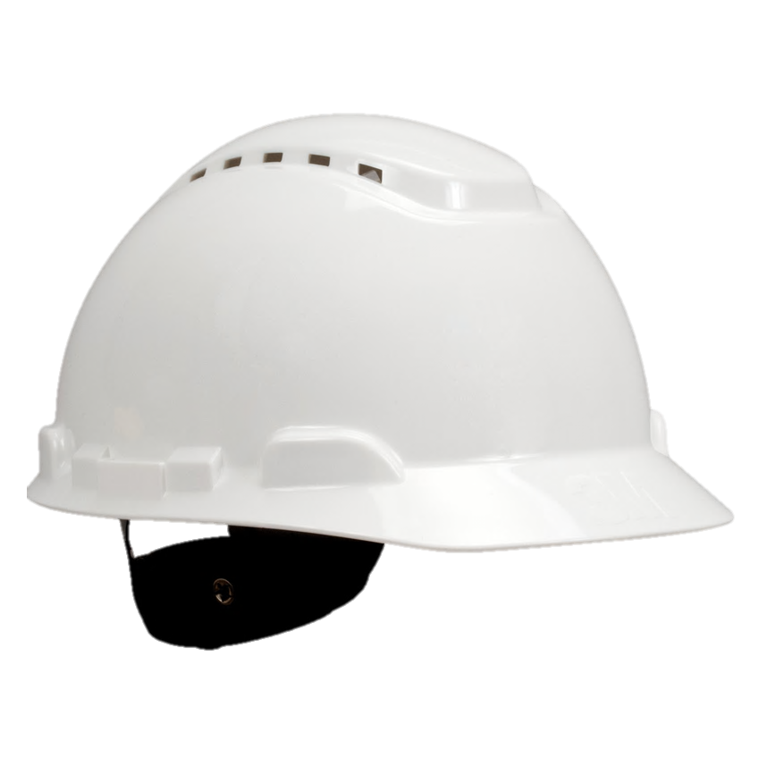

BENEFITS OF A
HEALTHY SAFETY CULTURE
Lower Accident Rates
Increased Morale
Improved Productivity
You Feel
Engaged and Empowered
Notes:
Benefits of a Positive Safety Culture
Increased Employee Morale: A strong safety culture enhances job satisfaction.
Lower Accident Rates: A focus on safety reduces the likelihood of incidents.
Improved Productivity: Safe environments lead to smoother operations and less downtime.
You Feed Engaged and Empowered: Employees feel that their contributions are impactful and matter.
A healthy safety culture leads to higher employee morale, improved productivity, fewer accidents, and lower operational costs. Employees feel valued, empowered, and are more likely to be engaged in their roles when safety is prioritized. Consider an example where focusing on safety noticeably improved your team's overall morale and efficiency.

Slide 7

indicators of an
UNHEALTHY
safety culture
Notes:
Indicators of an Unhealthy Safety Culture
Frequent Accidents: Regular incidents indicate a lack of effective safety practices.
Poor Communication: Ineffective communication of safety concerns increases risks.
Low Employee Engagement: Disengaged employees may not prioritize safety.
: If you cannot operate safely, no one will want to work with, or for you.
Common indicators of a poor safety culture include frequent incidents, inadequate communication, and disengaged employees. Such issues increase workplace hazards and reduce trust among team members. Recognizing these signs early allows for corrective action before serious incidents occur. Think about warning signs you've seen in your experience - how were they addressed or could they have been handled better?

Slide 8

Impact of Safety Culture
Notes:
Positive Safety Culture:
Employee Empowerment: Workers take responsibility for their safety and that of their colleagues.
Proactive Risk Management: Safety issues are addressed before they lead to accidents.
Negative Safety Culture:
Increased Risk of Injury: A lack of safety focus leads to higher injury rates.
Low Trust: Distrust in management's safety commitment creates a toxic environment.

Slide 9
Impact of Safety Culture
Positive Safety Culture
Employee empowerment
Proactive Risk Management
Reporting Safety Incidents
Reporting Near-Misses
Reporting First-Aid
People are safe
Notes:
Positive Safety Culture:
Employee Empowerment: Workers take responsibility for their safety and that of their colleagues.
Proactive Risk Management: Safety issues are addressed before they lead to accidents.

Slide 10
Impact of Safety Culture
Positive Safety Culture
Negative Safety Culture
Employee empowerment
Proactive Risk Management
Reporting Safety Incidents
Reporting Near-Misses
Reporting First-Aid
People are safe
Increased Risk of Injuries
Low Trust
Injuries
No reporting
No Culture of Caring
People are NOT safe
Notes:
Negative Safety Culture:
Increased Risk of Injury: A lack of safety focus leads to higher injury rates.
Low Trust: Distrust in management's safety commitment creates a toxic environment.

Slide 11

Impact of Safety Culture
Positive Safety Culture
Negative Safety Culture
Employee empowerment
Proactive Risk Management
Reporting Safety Incidents
Reporting Near-Misses
Reporting First-Aid
People are safe
Increased Risk of Injuries
Low Trust
Injuries
No reporting
No Culture of Caring
People are NOT safe
Notes:
Positive Safety Culture:
Employee Empowerment: Workers take responsibility for their safety and that of their colleagues.
Proactive Risk Management: Safety issues are addressed before they lead to accidents.
Negative Safety Culture:
Increased Risk of Injury: A lack of safety focus leads to higher injury rates.
Low Trust: Distrust in management's safety commitment creates a toxic environment.

Slide 12
Six Pillars of Building a Positive Safety Culture
Continuous Improvement
Through Monitoring and Feedback
Visible and
Committed Leadership
Leaders must prioritize safety and model safe behavior and take accountability of their team.
Regularly assess and enhance safety
practices.
Proactive Risk
Management And Planning
Active Participation With
Learning From Experience
Engage workers in safety discussions and decision making.
Acknowledge safe behavior to motivate compliance.
Comprehensive Understanding And Compliance
Empowered and
Informed Workforce
Regular training ensures understanding of safety protocols.
Encourage reporting of unsafe conditions without fear of retaliation.
Notes:
Six Pillars of Building a Positive Safety Culture
Leadership Commitment/accountability: Leaders must prioritize safety and model safe behavior and take accountability of their team. (call and response – ask if this is something they do, what does it mean to them, if they are going to talk the talk – are they going to walk the walk)
Employee Involvement: Engage workers in safety discussions and decision-making.
Training and Education: Regular training ensures understanding of safety protocols. (you need to make time – no excuses, regular training promotes safety)
Open Communication: Encourage reporting of unsafe conditions without fear of retaliation. (call and response – what keeps people from speaking up? Fear/Complacency)
Recognition and Rewards: Acknowledge safe behavior to motivate compliance. (call and response – is this important, why? What do you to reward people)
Continuous Improvement: Regularly assess and enhance safety practices. (Always trying to do better - - Compliance >Bester > Excellence, make it personal)
Consider which of these pillars you currently excel at and which you find challenging to implement.

Slide 13
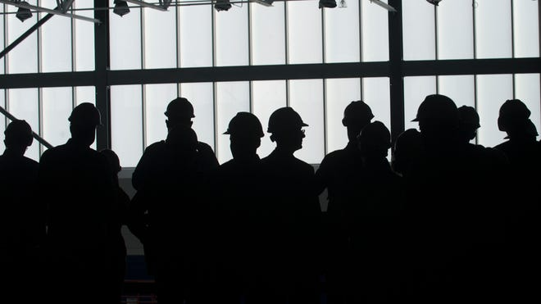
Value of Safety in the Workplace
Enhances Company Reputation
Reduces Costs
Ensures Compliance
Reduces Leadership Stress
Creates Trust and Builds Respect
Notes:
Value of Safety In the Workplace
Enhances Company Reputation: A commitment to safety attracts talent and clients.
Reduces Costs: Fewer accidents lead to lower insurance premiums and liability costs.
Ensures Compliance: Adhering to safety regulations protects the company from legal issues.
Reduces Leadership Stress: Reduces stress for the foreman and allows for the foreman to focus on their other duties.
Creates Trust and Builds Respect: Helps build relationships.
Safety in the workplace is not only a legal and moral obligation - it’s vital to our reputation and your personal reputation as a leader. It reduces operational costs and enhances team cohesion. As a Foreman, your role includes modeling safety behaviors, communicating effectively, and proactively managing risks. Think about how your prioritization of safety impacts your team's trust and respect for you as a leader.

Slide 14
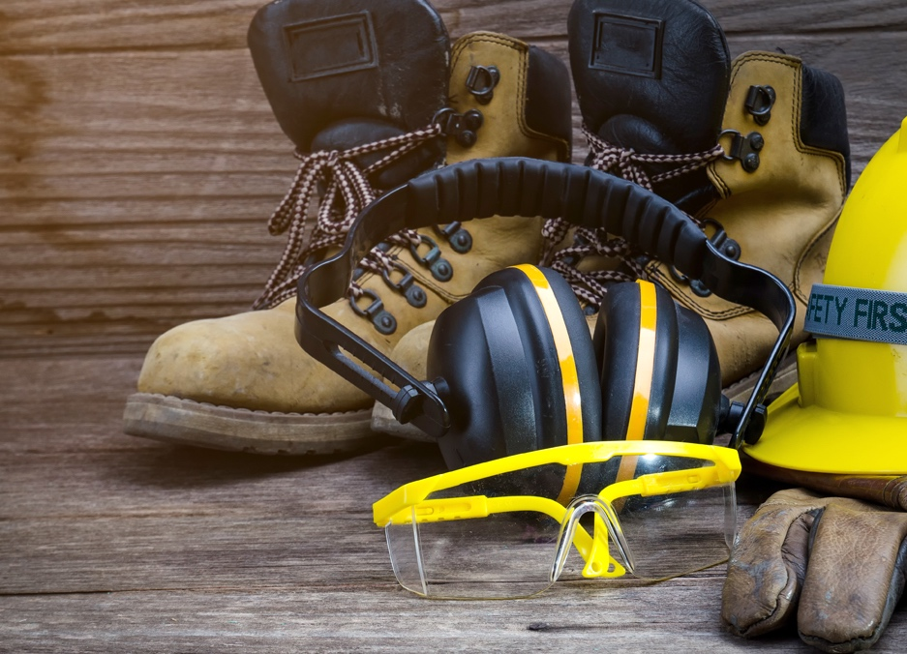
Role of a Foreman in Promoting Safety
As a foreman, you are a key safety representative. Your responsibilities include:
Modeling safe behavior
Participating in safety meetings
Monitoring work practices
Encouraging feedback
Notes:
Role of a Foreman in Promoting Safety
As a foreman, you are a key safety representative. Your responsibilities include:
Modeling Safe Behavior: Demonstrate the behavior you expect from your crew, best practices in daily activities.
Participating in Safety Meetings: Regularly discuss safety topics with your team.
Monitoring Work Practices: Ensure that safety protocols are consistently followed. (Safety, Material, Personal)
Encouraging Feedback: Ask questions and create an environment where team members can voice safety concerns. (call and response - What does this mean?)

Slide 15
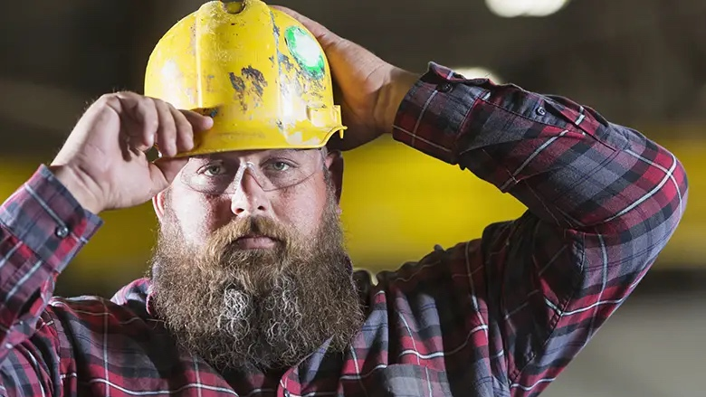
REMEMBER
CREATING SAFETY CULTURE IS A SHARED RESPONSIBILITY. YOU ARE SAFETY.
WE ARE SAFETY.
Notes:
Recap
Creating a robust safety culture is a shared responsibility. As foremen, you are responsible for this, you lead this effort. By prioritizing safety, communicating openly, and engaging your team, we can build a safer workplace for everyone. Remember: You are safety, we are safety!

Slide 16
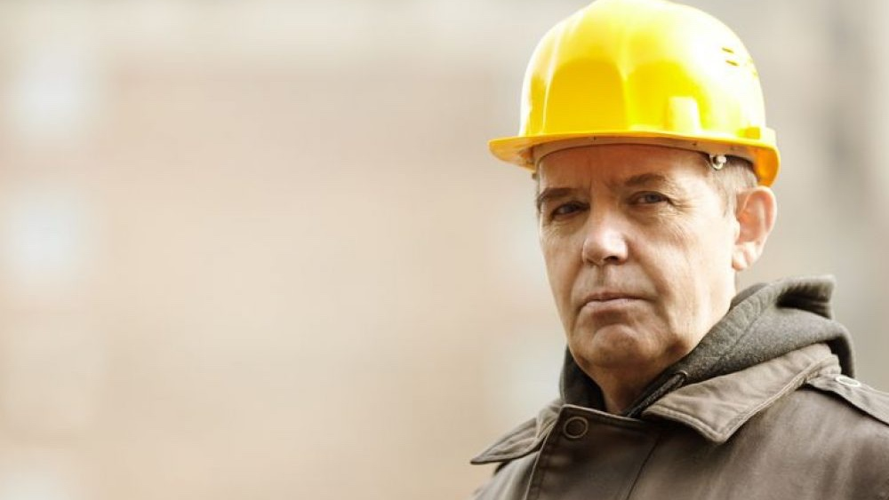
The Importance
of a Foreman

Slide 17

Importance of the Foreman
Definition
noun
1. A worker who supervises and directs other workers.
Notes:
The Importance of the Foreman’s Role
Definition of a Foreman -
Leadership in Safety
Overview of the foreman’s responsibilities in ensuring safety on the job site.
Effective leadership can prevent accidents and improve overall safety culture.
Partner with the Safety Team – Safety has targeted training, Safety can help
Influence on Team Dynamics
Understanding how the foreman’s actions and attitudes shape the team's perspective on safety.

Slide 18
Importance of the Foreman
Leadership in Safety
Safety on the job starts with the Foreman and the culture they create.
Influence on Teamwork
Remember, your actions and attitude share the team's perspective on safety.
Notes:
The Importance of the Foreman’s Role
Definition of a Foreman -
Leadership in Safety
Overview of the foreman’s responsibilities in ensuring safety on the job site.
Effective leadership can prevent accidents and improve overall safety culture.
Partner with the Safety Team – Safety has targeted training, Safety can help
Influence on Team Dynamics
Understanding how the foreman’s actions and attitudes shape the team's perspective on safety.

Slide 19
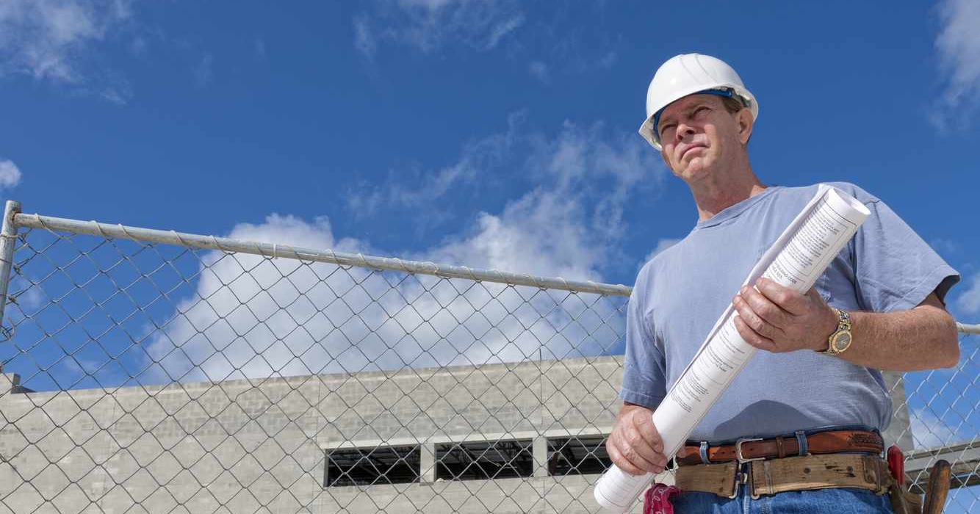
RECOGNIZE
the impact of your role
Practice Self-Awareness
Be more aware of your responsibility as a Foreman, and the impact of your words and actions on other people.
You Set the Tone
You set the tone for the team with your attitude and behavior, and it then becomes the team’s behavior, all day, from beginning to end.
Notes:
Recognizing the Impact of Your Role
Self-Reflection/Self-Awareness
Reflecting on personal responsibility as a foreman and the implications of your behavior.
The ripple effect: how a foreman's attitude influences the entire crew’s approach to safety, all day, from beginning to the end.
Be more self-aware of the impact of your words and actions on your team.
Setting the Tone
Your behavior becomes their behavior
Discussing the importance of maintaining a positive, safety-oriented mindset.
As a Foreman, you lead by example
(call and response – what does that mean, to lead by example?)

Slide 20
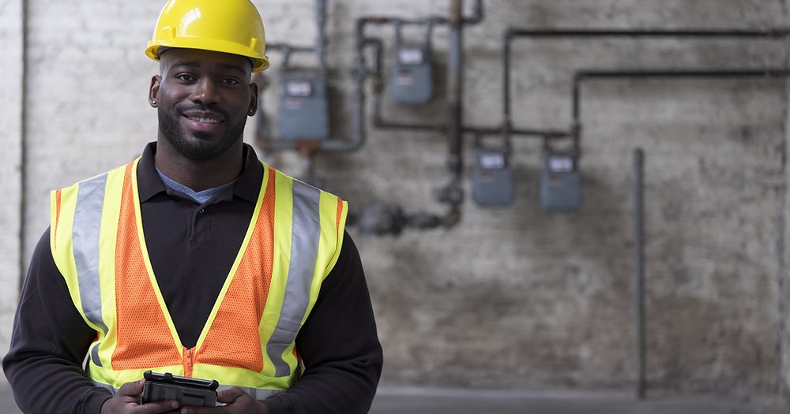
Caring As a Foreman
Safety
Health
Well-being
Caring about people does not mean warm hugs, hearts, and songs. It means that you take a genuine interest in your people.
Notes:
Caring as a Foreman
It Is not hearts, rainbows, and warm hugs…
Demonstrating Genuine Care
How showing concern for crew members' well-being fosters a culture of care.
Building relationships based on trust and respect to enhance teamwork.
(call and response – Do you care about your crew/team? Does it matter? Why/why not?
Team Morale
The connection between a foreman’s attitude and crew morale; when foremen care, the crew is more likely to care as well.
Remember, “Its not about you – it’s about your crew.”
(call and response – How do you build the morale of your crew? Have you been part of a crew where no one cared? How did that work out?)

Slide 21
Caring As a Foreman
We care because:
It’s the right thing to do.
When you care about people and connect with them, they care about you, too.
People will feel respect and loyalty to someone who cares about them.
Notes:
Caring as a Foreman
It Is not hearts, rainbows, and warm hugs…
Demonstrating Genuine Care
How showing concern for crew members' well-being fosters a culture of care.
Building relationships based on trust and respect to enhance teamwork.
(call and response – Do you care about your crew/team? Does it matter? Why/why not?
Team Morale
The connection between a foreman’s attitude and crew morale; when foremen care, the crew is more likely to care as well.
Remember, “Its not about you – it’s about your crew.”
(call and response – How do you build the morale of your crew? Have you been part of a crew where no one cared? How did that work out?)

Slide 22
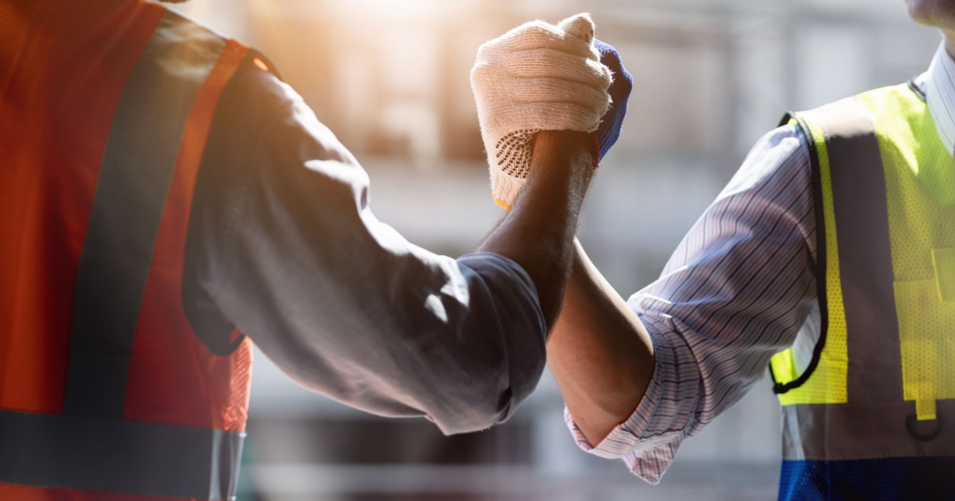
Earning Respect
As A Foreman
Actions Speak Louder Than Words
Lead by example and model safe practices
Engage with your crew and show that their safety is a priority
Ensure that everyone on the crew understands your message
Build Credibility
Earn and maintain the respect of your crew
Practice being consistent, accountable, and transparent
Notes:
Earning Respect as a Foreman
Actions Speak Louder Than Words
The importance of leading by example and demonstrating safe practices.
Engaging with the crew and showing that their safety is a priority.
Ensure everyone understands the purpose of your message and behavior.
Building Credibility
Strategies for earning and maintaining respect: consistency, accountability, and transparency.
(call and response – we live in a world where people demand respect, how do you build it?

Slide 23

Effective Communication
Techniques for Clear and Effective Communication
Speak Clearly and Concisely
Provide Context and Examples
Use Multiple Communication Methods
Encourage Two-Way Communication
Be Assertive and Respectful
Document and Review
Notes:
Communicating Effectively
Getting Your Point Across
Techniques for clear and effective communication, especially regarding safety procedures and expectations.
The importance of active listening and addressing crew concerns.
Adapting Communication Styles
Recognizing different communication styles within the team and adjusting your approach accordingly.
Techniques for Clear and Effective Communication:
Speak Clearly and Concisely:
Use plain language, avoid jargon, and ensure your message is easy to understand.
Provide Context and Examples:
Explain the "why" behind safety procedures and use real-world examples to illustrate potential consequences.
Use Multiple Communication Channels:
Combine different methods like emails, newsletters, meetings, posters, and videos to reach everyone.
Encourage Two-Way Communication:
Create opportunities for questions and feedback to ensure everyone understands and feels heard.
Be Assertive and Respectful:
Express your thoughts and needs clearly and directly, while also respecting the opinions and concerns of others.
Document and Review:
Keep records of safety communications and regularly review them to identify areas for improvement.

Slide 24

Communicating Effectively
The Importance of Active Listening and Addressing Crew Concerns
Active Listening
Acknowledge and Validate Concerns
Seek Clarification
Respond Thoughtfully and Promptly
Document and Follow Up
Notes:
Communicating Effectively
Getting Your Point Across
Techniques for clear and effective communication, especially regarding safety procedures and expectations.
The importance of active listening and addressing crew concerns.
Adapting Communication Styles
Recognizing different communication styles within the team and adjusting your approach accordingly.
The Importance of Active Listening and Addressing Crew Concerns:
Active Listening:
Pay full attention to what others are saying, both verbally and nonverbally, and show that you understand their point of view.
Acknowledge and Validate Concerns:
Show empathy and validate the concerns of team members, even if you don't agree with them.
Seek Clarification:
Don't assume you understand, ask clarifying questions to ensure everyone is on the same page.
Respond Thoughtfully and Promptly:
Address concerns and questions promptly and provide clear and actionable solutions.
Document and Follow Up:
Keep records of concerns and actions taken, and follow up to ensure issues are resolved.

Slide 25

Communicating Effectively
Adapting Your Communication Style
Observe and Identify
Be Flexible
Use Multiple Channels (Methods)
Be Mindful of Nonverbal Cues
Seek Feedback
Notes:
Communicating Effectively
Getting Your Point Across
Techniques for clear and effective communication, especially regarding safety procedures and expectations.
The importance of active listening and addressing crew concerns.
Adapting Communication Styles
Recognizing different communication styles within the team and adjusting your approach accordingly.
Adapting Communication Styles:
Observe and Identify:
Pay attention to how team members communicate with each other and with you, and identify their preferred communication styles.
Be Flexible:
Adjust your communication style to match the individual needs of your team members.
Use Multiple Channels:
Recognize that some people prefer written communication, while others prefer face-to-face interactions.
Be Mindful of Nonverbal Cues:
Pay attention to body language and tone of voice, as these can convey important information.
Seek Feedback:
Ask team members for feedback on how you communicate and make adjustments as needed.

Slide 26
TAKEAWAYS
what are your key takeaways?
Notes:
Recap
Ask participants for their Takeaways.

Slide 27
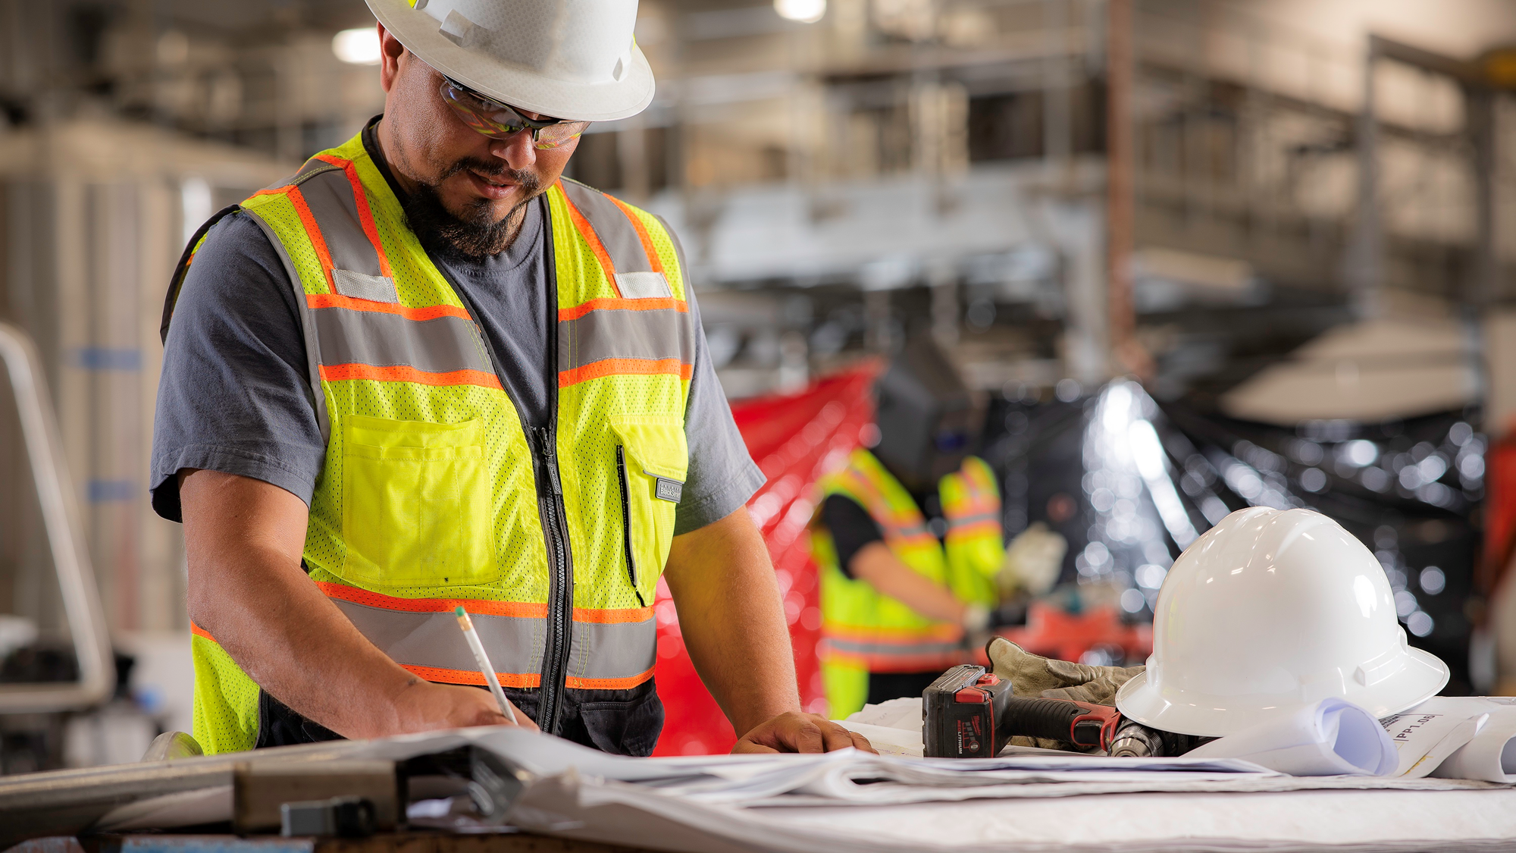
Leading By Example
Notes:
Foreman Leadership

Slide 28

OBJECTIVES
Explain the critical role of a Foreman in ensuring safety on the jobsite.
Emphasize the importance of preparation and proactive planning.
Reinforce the responsibility of a Foreman as a representative of the Brycon brand.
Notes:
Objectives
Understand the critical role of a foreman in ensuring safety and quality on the job site.
Emphasize the importance of preparation and proactive planning.
Reinforce the foreman's responsibility as a representative of the Brycon brand.
What is teamwork – a group of people working together toward a common goal

Slide 29
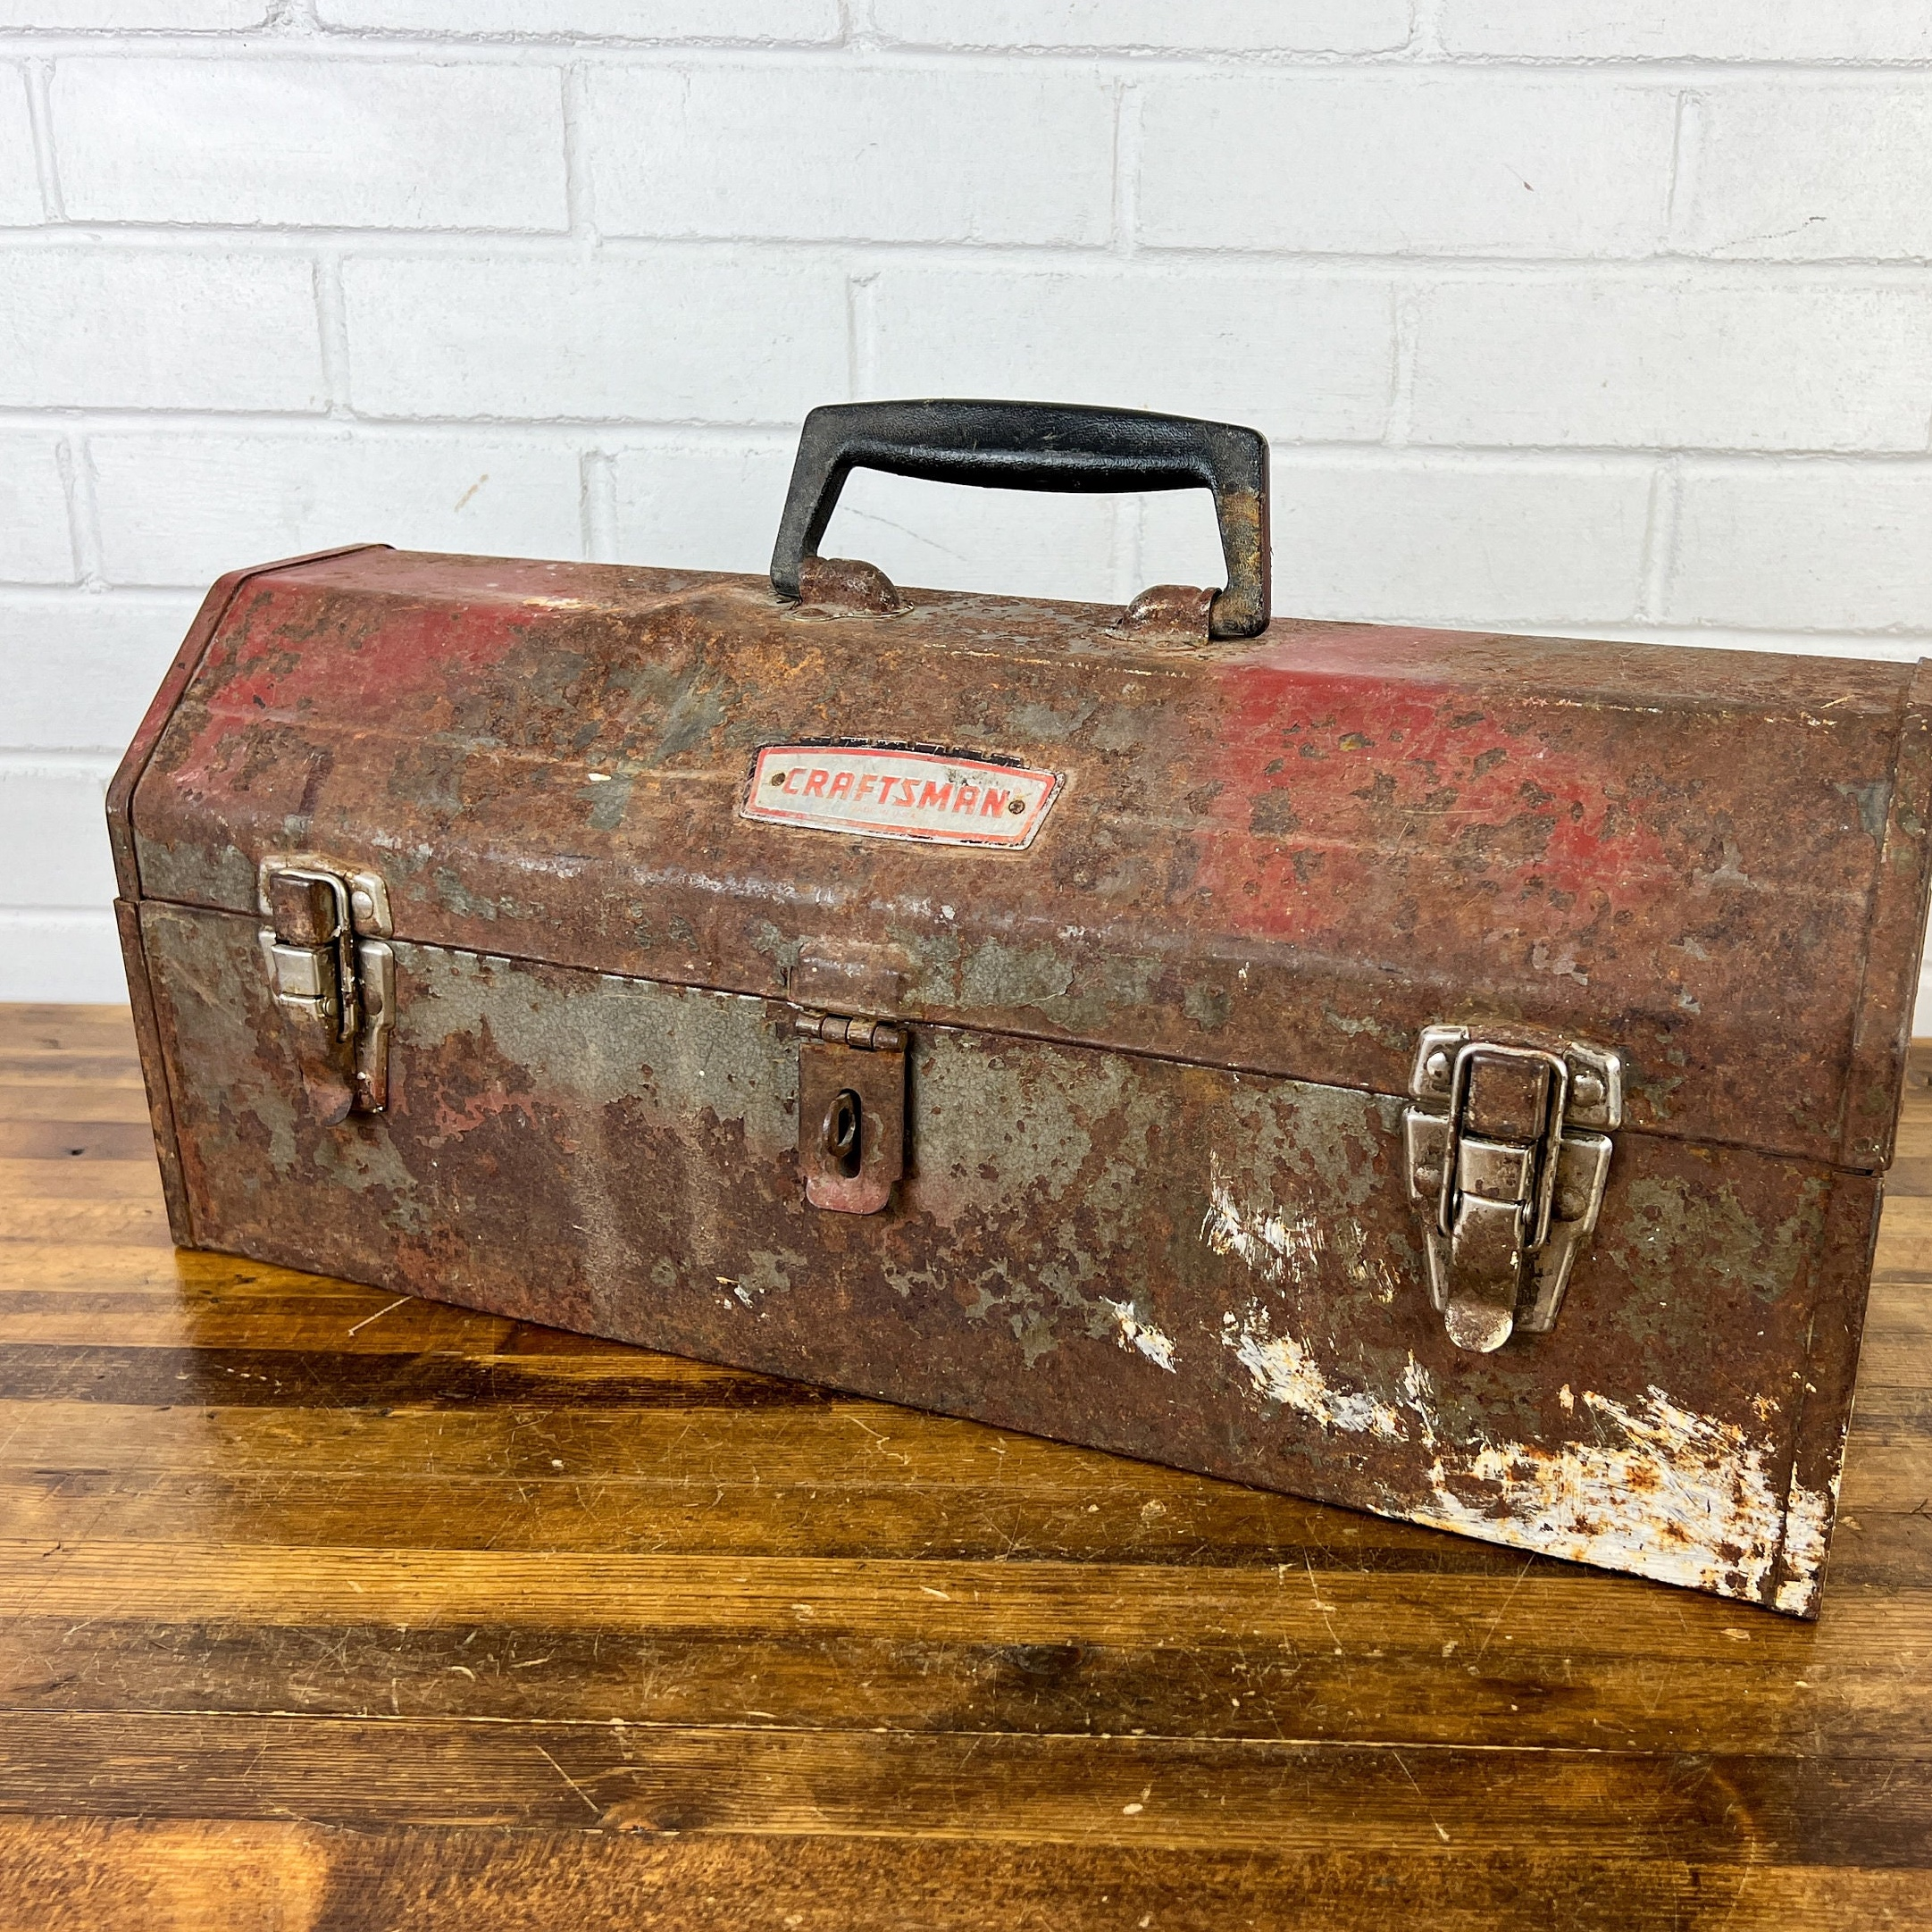
Add These 6 Behaviors To Your Professional Toolbox
Leading by example
Thorough training
Decision-making for safety
Proactive hazard management
Become accountable
Representation of the company brand
Notes:
Key Topics
Leading by Example (call and response – what does it mean?)
Consistently demonstrate safe practices.
Set a standard for the crew to follow; actions speak louder than words.
The words you use matter, too!
Foster a culture of safety through visible commitment.
Your attitude will become their attitude
Thorough Training (call and response – is training important? What training do you need?)
Ensure foremen are well-trained in tasks assigned to their crews.
Promote ongoing education to stay updated on best practices.
Encourage seeking knowledge of new techniques and equipment.
Decision-Making for Safety (call and response – are you good at making decisions?)
Make informed decisions that prioritize safety.
Evaluate potential risks and implement measures to mitigate them.
Encourage open communication about safety concerns among crew members.
(ask for examples of good decisions and bad decisions that they have made – you have to make mistakes to learn from them.)
Proactive Hazard Management
Engage in detailed planning to identify and eliminate safety hazards.
Conduct regular safety audits and inspections.
Implement corrective actions promptly.
(call and response – sounds like a PTP)
Accountability
Be present
Be active and engaged in the team’s activities
Take responsibility for safety of the team
Accept ownership of actions and outcomes – failures and successes.
Representation of the company Brand (call and response – what does this mean)
Understand the impact of actions on the company's reputation.
Uphold the highest ethical standards in all interactions.
Act as a role model, fostering teamwork and respect among crew members.
Beings safe at work builds our reputation and yours
Lives the company core values

Slide 30
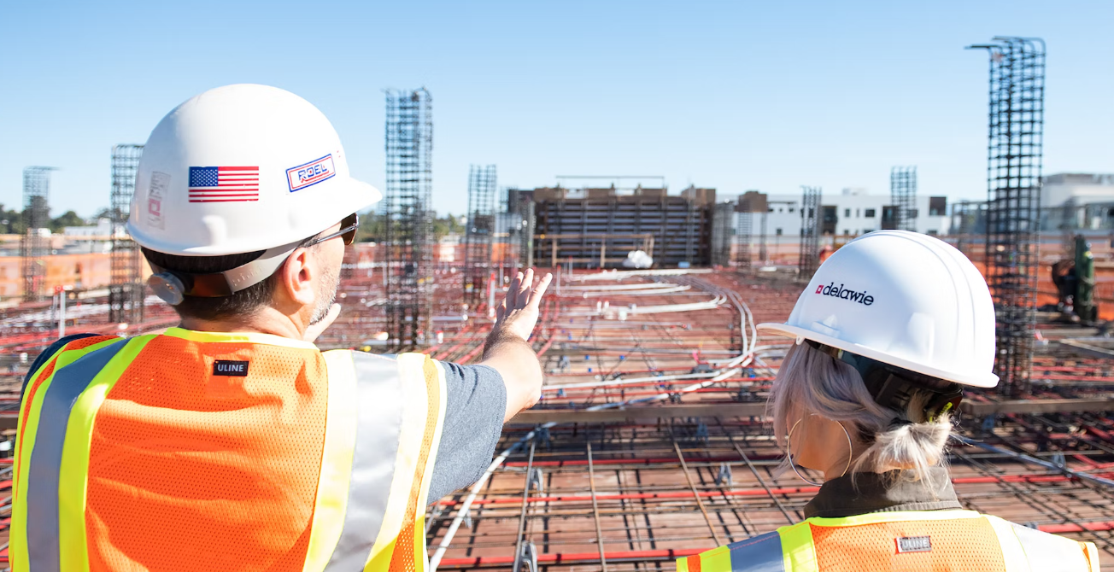
1
leading by
EXAMPLE
Consistently demonstrate safe practices.
Set a standard for the crew to follow; actions speak louder than words.
The words you use matter, too!
Foster a culture of safety through visible commitment.
Your attitude will become their attitude
Notes:
Leading by Example (call and response – what does it mean?)
Consistently demonstrate safe practices.
Set a standard for the crew to follow; actions speak louder than words.
The words you use matter, too!
Foster a culture of safety through visible commitment.
Your attitude will become their attitude

Slide 31

2
thorough
TRAINING
Ensure foreman are well-trained in tasks assigned to their team.
Promote ongoing education to stay updated on best practices.
Encourage seeking knowledge of new techniques and equipment.
Notes:
Thorough Training (call and response – is training important? What training do you need?)
Ensure foremen are well-trained in tasks assigned to their crews.
Promote ongoing education to stay updated on best practices.
Encourage seeking knowledge of new techniques and equipment.

Slide 32

3
decision-making
FOR SAFETY
Make informed decisions that prioritize safety.
Evaluate potential risks and implement measures to mitigate them.
Encourage open communication about safety concerns among crew members.
Notes:
Decision-Making for Safety (call and response – are you good at making decisions?)
Make informed decisions that prioritize safety.
Evaluate potential risks and implement measures to mitigate them.
Encourage open communication about safety concerns among crew members.
(ask for examples of good decisions and bad decisions that they have made – you have to make mistakes to learn from them.)

Slide 33
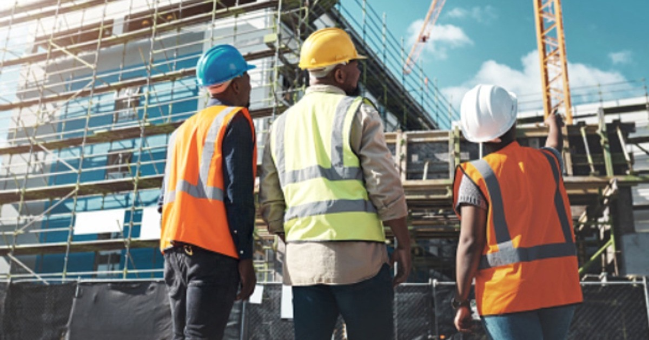
4
proactive hazard
MANGEMENT
Engage in detailed planning to identify and eliminate safety hazards.
Conduct regular safety audits and inspections.
Implement corrective actions promptly.
Notes:
Proactive Hazard Management
Engage in detailed planning to identify and eliminate safety hazards.
Conduct regular safety audits and inspections.
Implement corrective actions promptly.
(call and response – sounds like a PTP)

Slide 34

5
become
ACCOUNTABLE
Be present.
Be active and engaged in the team’s activities.
Take responsibility for the safety of the team.
Accept ownership of actions and outcomes – failures and successes.
Notes:
Accountability
Be present
Be active and engaged in the team’s activities
Take responsibility for safety of the team
Accept ownership of actions and outcomes – failures and successes.

Slide 35
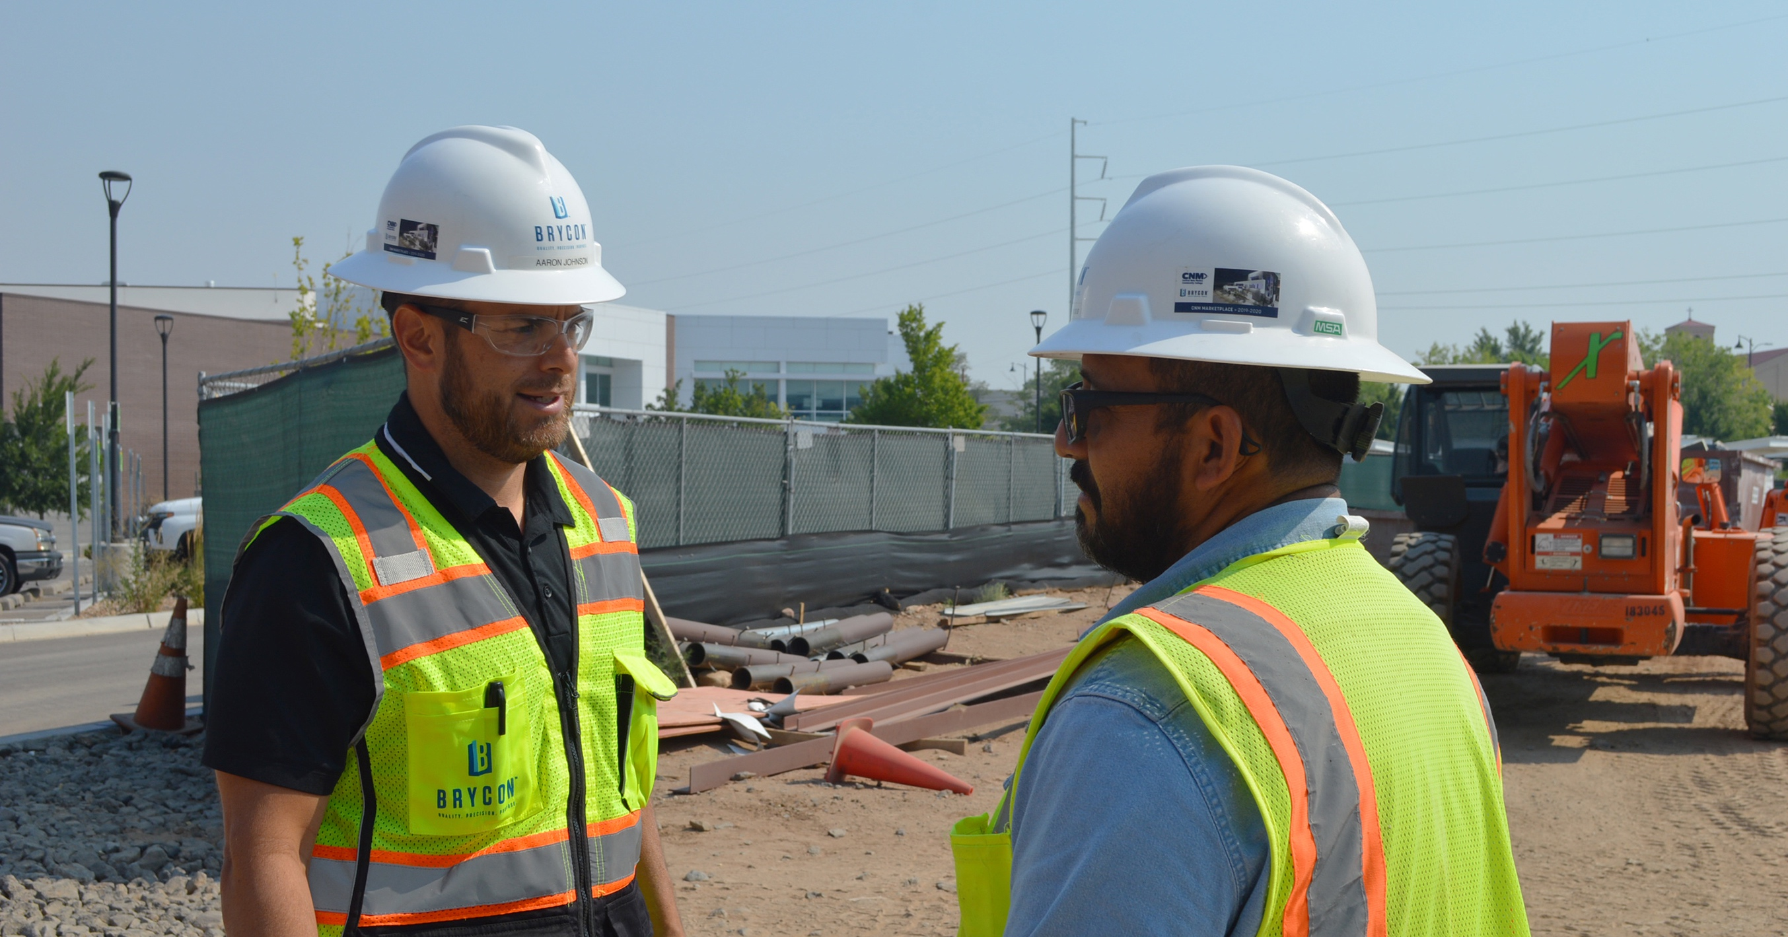
6
representation of
THE BRAND
Understand the impact of actions on the company's reputation.
Uphold the highest ethical standards in all interactions.
Act as a role model, fostering teamwork and respect among crew members.
Beings safe at work builds our reputation and yours
Live company’s Core Values
Notes:
Representation of the Brycon Brand (call and response – what does this mean)
Understand the impact of actions on the company's reputation.
Uphold the highest ethical standards in all interactions.
Act as a role model, fostering teamwork and respect among crew members.
Beings safe at work builds our reputation and yours
Lives the company’s Core Values

Slide 36
Add These 6 Behaviors To Your Professional Toolbox
Leading by example
Thorough training
Decision-making for safety
Proactive hazard management
Become accountable
Representation of the brand
Notes:
Key Topics
Leading by Example (call and response – what does it mean?)
Consistently demonstrate safe practices.
Set a standard for the crew to follow; actions speak louder than words.
The words you use matter, too!
Foster a culture of safety through visible commitment.
Your attitude will become their attitude
Thorough Training (call and response – is training important? What training do you need?)
Ensure foremen are well-trained in tasks assigned to their crews.
Promote ongoing education to stay updated on best practices.
Encourage seeking knowledge of new techniques and equipment.
Decision-Making for Safety (call and response – are you good at making decisions?)
Make informed decisions that prioritize safety.
Evaluate potential risks and implement measures to mitigate them.
Encourage open communication about safety concerns among crew members.
(ask for examples of good decisions and bad decisions that they have made – you have to make mistakes to learn from them.)
Proactive Hazard Management
Engage in detailed planning to identify and eliminate safety hazards.
Conduct regular safety audits and inspections.
Implement corrective actions promptly.
(call and response – sounds like a PTP)
Accountability
Be present
Be active and engaged in the team’s activities
Take responsibility for safety of the team
Accept ownership of actions and outcomes – failures and successes.
Representation of the Company Brand (call and response – what does this mean)
Understand the impact of actions on the company's reputation.
Uphold the highest ethical standards in all interactions.
Act as a role model, fostering teamwork and respect among crew members.
Beings safe at work builds our reputation and yours
Lives Company’s Core Values

Slide 37

Foremen play a pivotal role in maintaining safety and productivity on the job site. Only through leading by example and managing safety, can Foremen create a safe and efficient work environment.
Notes:
Conclusion
Foremen play a pivotal role in maintaining safety and productivity on the job site. By leading by example and proactively managing safety, foremen can create a safe and efficient work environment.

